Slide 1
How Does Communication Affect Teens Mental Health?
By: Grace Pantolin

Slide 2
Tight/smaller groups(youth group, club or sports team)
I believe that a tighter or smaller group of people can affect a teens mental health. This group could be a youth group at church, a sports team, or a club. But personally, I would say this can give teens a supportive group they can turn to for questions or help if needed.

Slide 3
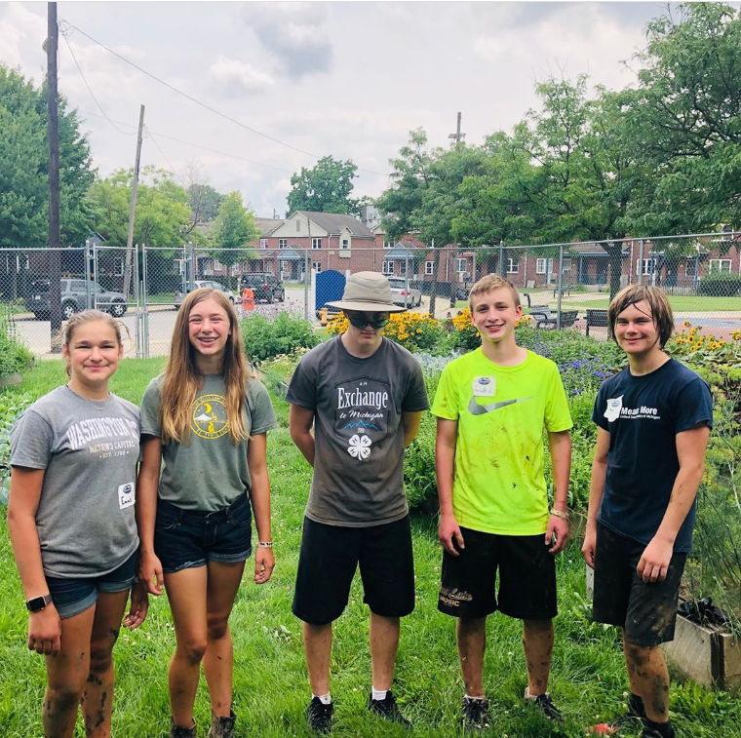

Slide 4


Slide 5
Family (siblings, cousins, parents, grandma, grandpa, ect…)
Family can also be a big influence on a teens mental health. For example, parents are people teens look up to. And depending on how the parents are involved in the teens life and how they react to their teen can affect the teens mental health.

Slide 6


Slide 7
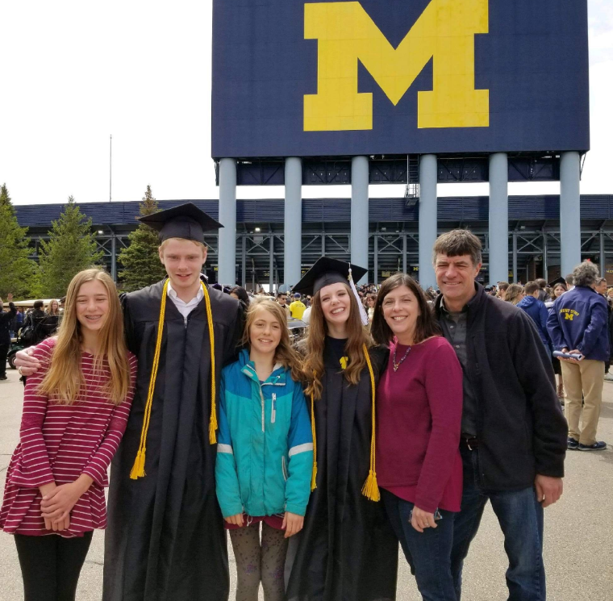

Slide 8
Bigger city(more people) vs. Smaller city/town(less people)
In my opinion, depending on whether you live in a big city with a lot of people or in a smaller city or town with less people. When you are in a place with more people this could either give you more options of people to go to when needed, or it could restrict your choices because there is no connection with a smaller group of people who are closer. Whereas if you live in a smaller city or town, it could limit the amount of people you know and can talk to but also you could be closer with a smaller group of people you can talk to.

Slide 9
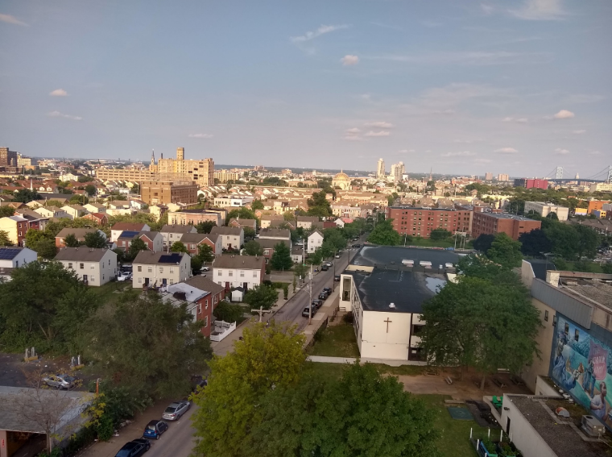

Slide 10


Slide 11
Pets in the home/place of residence
I personally think that pets can have a big impact on a teens mental health. For example, cats and dogs can stand as emotional support animals and help people in different situations depending on what they struggle with. Pets in general can be comforting to talk to or just pet.

Slide 12
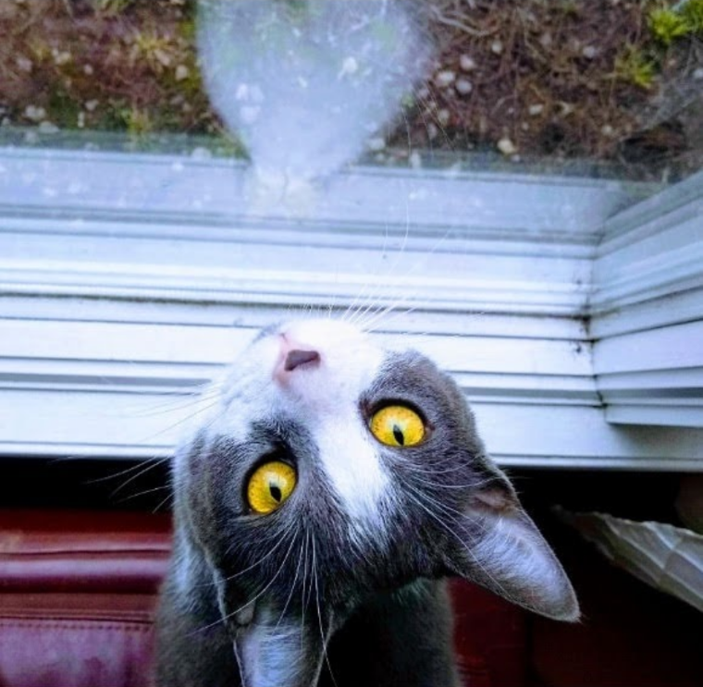

Slide 13


Slide 14
School environment(friends)
School environment can affect teens mental health based on the staff and other students. For example if teens have a good group of friends and a good relationship with their teachers they are more likely to do better in school and have better mental health. But at the other end of the line would be not having at least a few good friends and not the best relationship with their teachers could affect their mental health and grades which can also affect how the teen feels about school and their mental health even more.

Slide 15
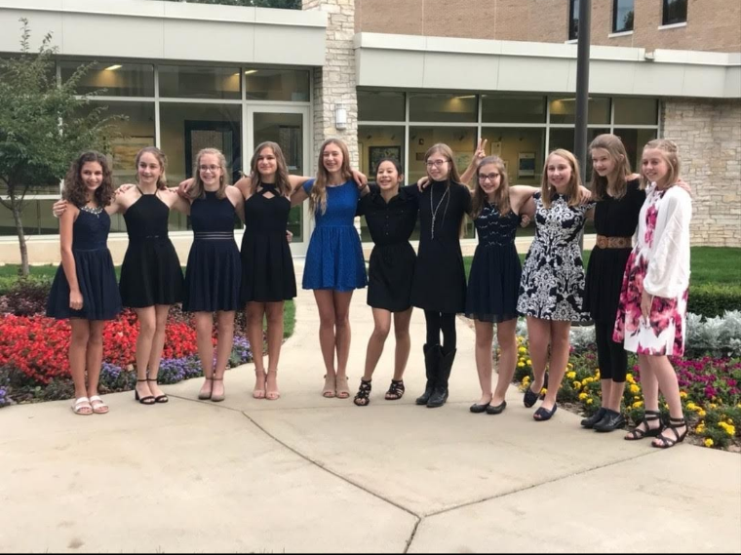

Slide 16
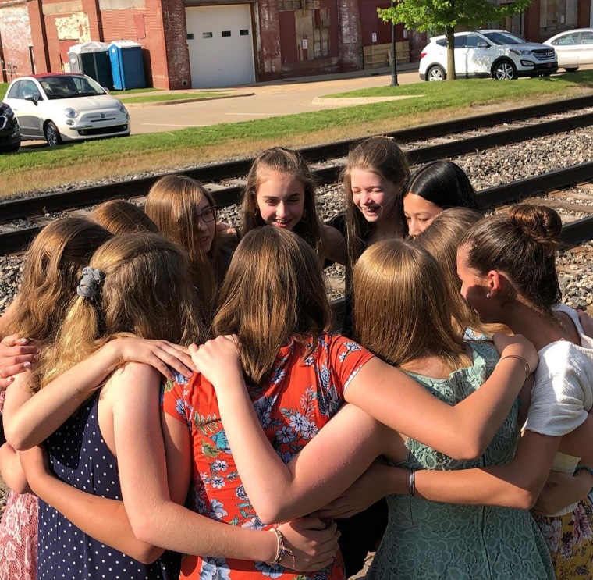

Slide 17



The 4HChangemakers is a group of Washtenaw County students (ages 13-18) whose goal is to raise student awareness and help educate their peers about what they can do (for themselves and others) regarding youth mental health in their communities. The students have hosted education/outreach events and trainings.
Teens use digital storytelling to increase awareness and destigmatize mental health through social media and (now virtual) public exhibits. Local and online experts share knowledge of tools to help tell stories: photography, graphic arts, videography, podcasting, interview techniques, meme making, and more. The group continues to explore innovative ways to humanize stories and share information with their peers.
This 4H Changemakers 2020 Digital Exhibit – STOMP OUT STIGMA -
is made possible thanks to generous funding from 4H, Microsoft, and University of Michigan Community Health Services.
Contact Washtenaw County 4H for more information about this and other teen mental health initiatives at (734) 222-3900 https://www.canr.msu.edu/washtenaw/washtenaw_county_4_h/

